Slide 1
Scholar Biographies
Sponsored by the SSUNAA-Class of 1976 Chapter, Inc. Then and Now

Slide 2
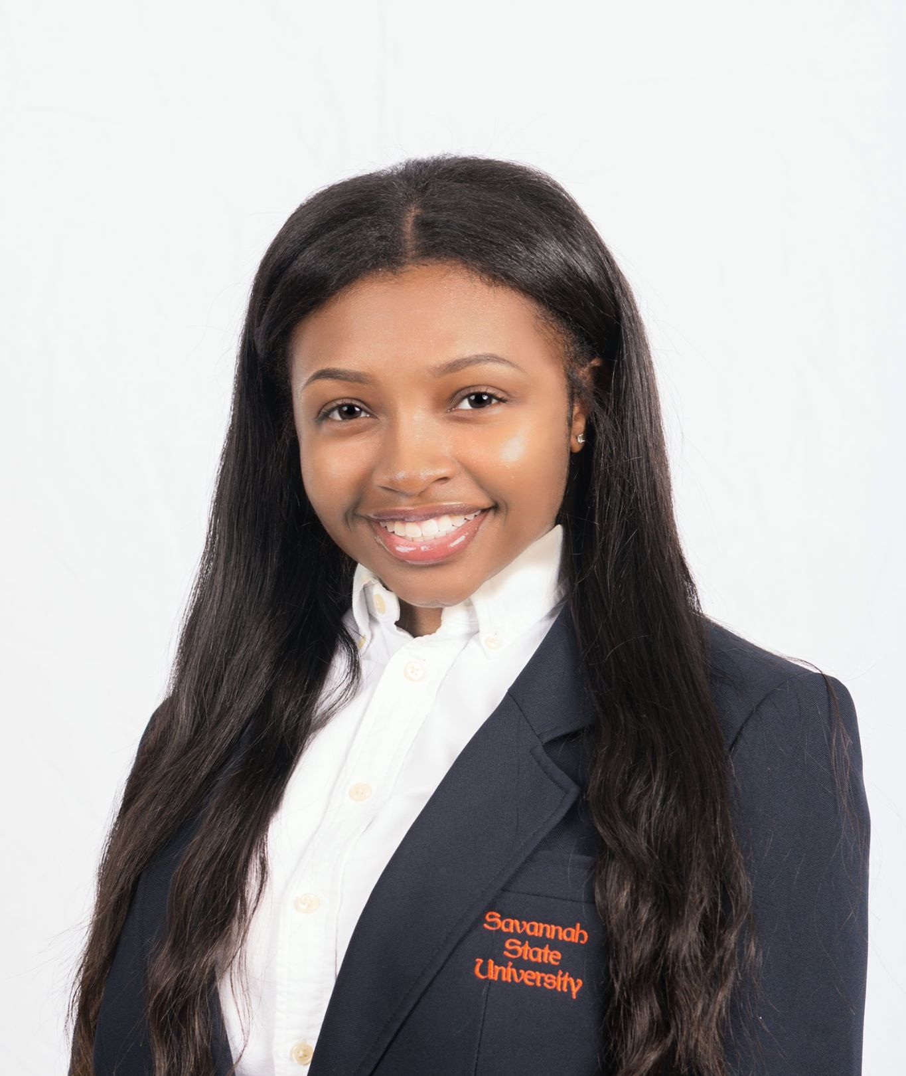
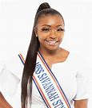
Miss Aaliyah Buckholts
Graduated Dec. 2020
Hometown: Riverdale, GA
Major: Mathematics w/ track in Secondary Education
Parent: Alyssa Zackery
HONORS, AWARDS, RECOGNITION, and COMMUNITY SERVICE
Miss Savannah State University 2019-2020, Honors Program, University System of GA Board of Regents Academic Recognition Day Honoree , HBCU White House Initiative Scholar , Gold Medallion Scholar, Tutor, Read Across America, Azalea Land Nursing Home, Oglethorpe Charter School
Now: Mathematics Educator at Charles R. Drew High School, Atlanta Metropolitan Area Schools

Slide 3
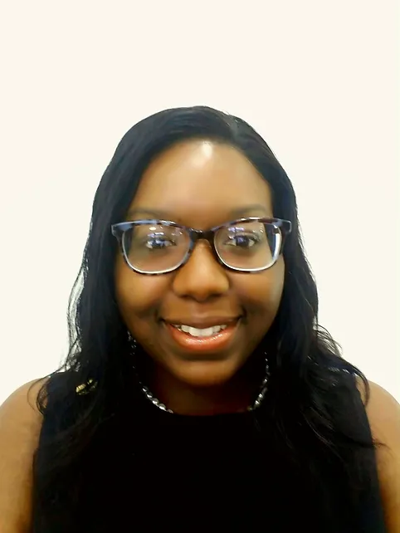
Miss Emmanuella S. Martin
Inducted into ALPHA KAPPA MU Honor Society, April 2022
$1,000 per year
Hometown: East Dublin, GA
Parent: Yalonda Martin
Major: Forensic Science
Graduate of East Laurens High School
HONORS, AWARDS, RECOGNITION, and COMMUNITY SERVICE
NAACP, East Laurens High School John Phillip Sousa Award, East Laurens High School Director’s Award
Emerald Business and Professional Women’s Scholarship, Savannah State Class of 1976 Scholarship, Savannah State University National Alumni Association Scholarship, Savannah State University President’s Scholarship, Savannah State University ADISRE Scholarship Program, Savannah State University Dean’s List Scholar, Savannah State University Katherine Toler Scholarship, Thurgood Marshall College Fund Scholarship

Slide 4
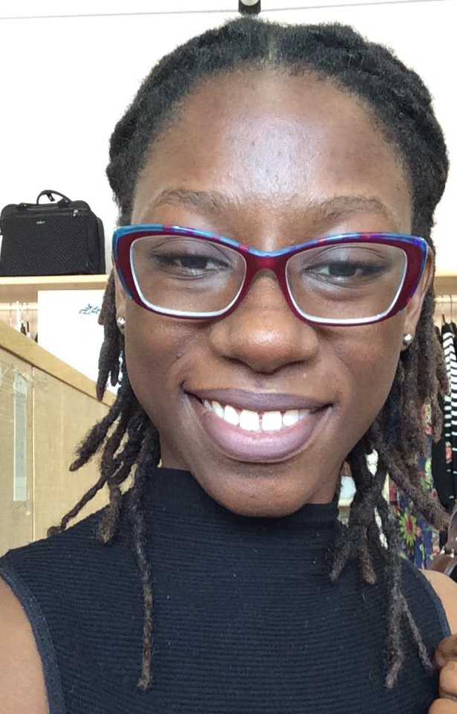
Miss Briana Byrne
Graduated Dec. 2020
$500 per semester
Hometown: Antiqua, West Indies
Parent: Wanda Byrne
Major: Forensic Science
HONORS, AWARDS, RECOGNITION, and COMMUNITY SERVICE
International Students Association, Student Government Association (SGA), Class of '76 scholar

Slide 5
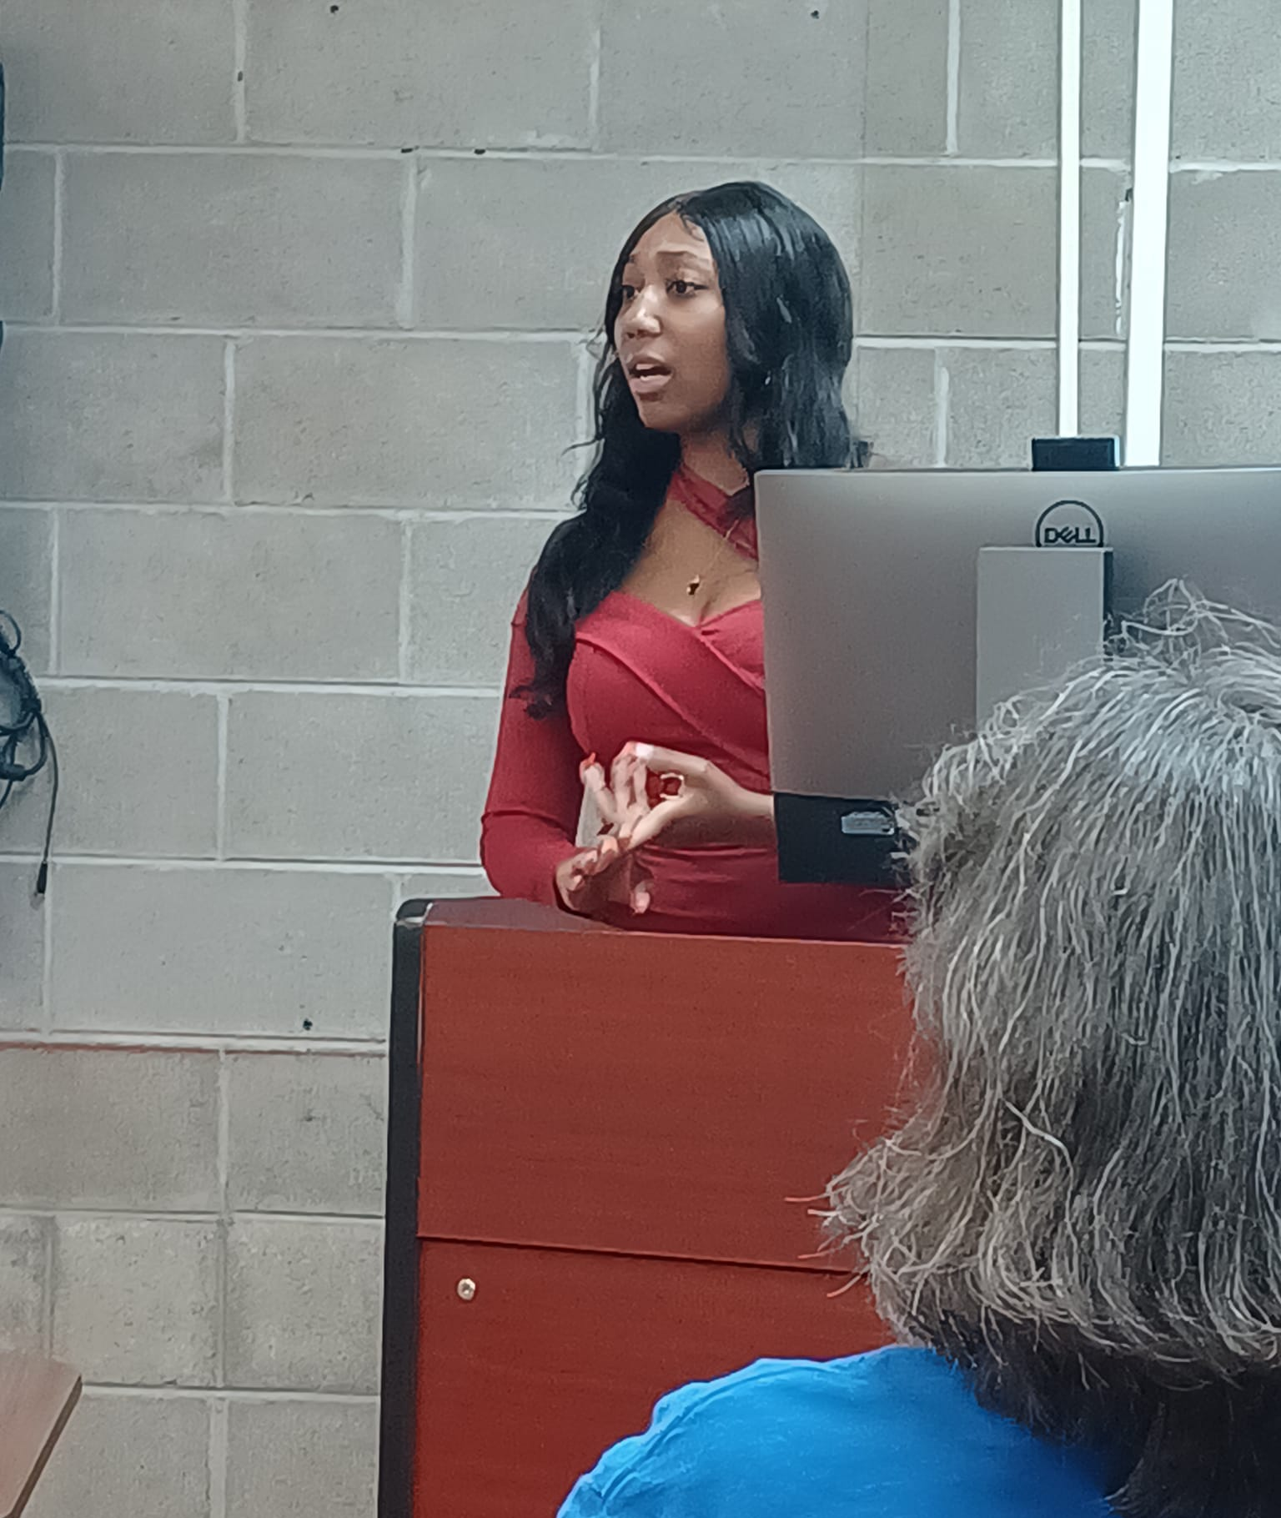
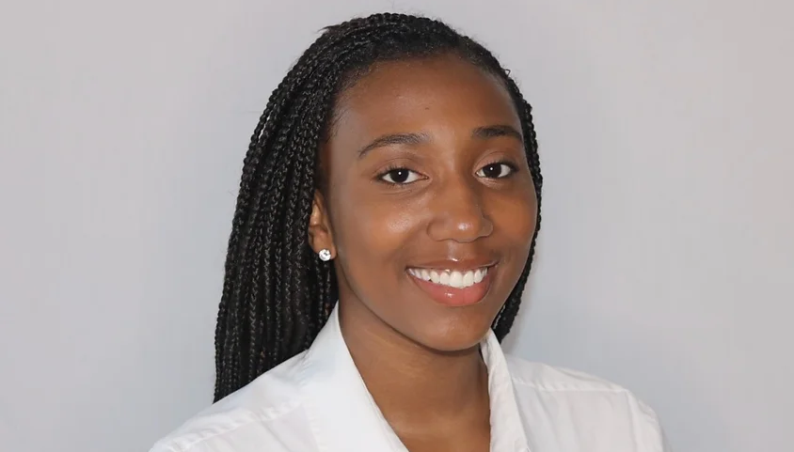
Miss Erianna S. Hammond Then and now…
Graduate, May 2022
$1,000 per year
Hometown: Chesapeake, VA
To follow Ms. Hammond's post-graduate professional work , check out this impressive professional project with the U.S. government and on LinkedIn.
Parent: Debra A. Dart
Major: Marine Sciences
HONORS, AWARDS, RECOGNITION, and COMMUNITY SERVICE
NAACP Savannah State Collegiate Chapter, SGA Executive Secretary, Environmental Science Club, Member of NAACP, Honor Roll All Semesters, National Society of Leadership and Success, Azaelaland Nursing Home Volunteer, Powerful Educated And Respectful LadieS (PEARLS) Adviser and Mentor (Western Branch High School mentoring group), Environment Clean-Up, Math and Science Tutor, Youth Praise and Worship Leader at Tidewater Bibleway Temple, Otis J. Brock Elementary School, Savannah, Volunteer Reader.
Erianna Hammond, member of the Delta Nu Chapter of Delta Sigma Theta Sorority, Inc., is a Marine Science major with a focus in Marine Mammalogy at Savannah State University. She is a 2x National Scholarship Recipient of the National Oceanic and Atmospheric Administration. In this program, Erianna has provided her scientific expertise in marine mammal research and ocean conservation in various locations in both the Atlantic and Pacific Ocean. Her research focuses on human impacts in relation to ocean life.

Slide 6
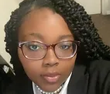
Miss Amaya Bennett, Graduate, Dec. 2022
$1,000 per year
Hometown: Decatur, GA
Congratulations to Ms. Bennett, winner of the 2022 Prevention Rising Star Award, August 31, 2022 in Savannah from the Georgia School of Addiction Studies.
Parent: Valencia Breedlove
HONORS, AWARDS, RECOGNITION, and COMMUNITY SERVICE
Decatur Prevention Initiative - Youth Platform -Career Association -Poetic Praise - SOAR (Student Organization Led Against Racism) -Budding Rose Debutante Program -Student Ambassador with The Decatur High school Student Center -21 Century Leaders, 3rd Place Poetry Slam (2016), 1st Place Poetry Slam (2017), Student Government Association 9th Grade President (2017), Inducted into Career Association (2017), Career Association Vice President of Leadership (2018-2019), Career Association President (2019-2020), 1st place for Outstanding Leadership with Job For Georgia Graduates (number one in the state of Georgia

Slide 7
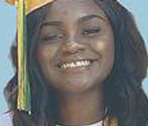
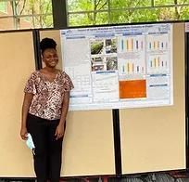
Dianah Anderson then and now…
Dianah Anderson Completes Summer 2022 Internship at UGA!
$1,000 per year
Hometown: Albany, GA
Parents: Tammy Cowart Anderson & Darroye Anderson
HONORS, AWARDS, RECOGNITION, and COMMUNITY SERVICE
Highest Average in Chemistry, Highest Average in 9th grade lit, A/B honor roll, BETA Club, Teacher as a Profession Pathway Completion, Teen Leader Certified, Principal’s Honor Roll at 4c Academy, Top 10% of the Class of 2020, Jefferson Street Boys & Girls Club (Feeding the Valley Food Bank)
Captain of Monroe Comprehensive High School Soccer Team, Member of Dougherty County 4-H club, Member of New Oak Grove Baptist Church and organizer of Dimes for Cancer Fundraiser, Youth Secretary of Mt. Hosea Union Meeting, Participant in Relay for Life, Member of New Oak Grove Young Adult Choir, Work Based Learning Student at the Boys & Girls Club, Feed the Valley Volunteer

Slide 8
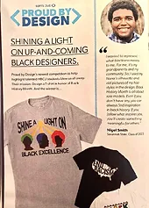
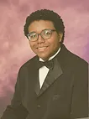
Mr. Nigel Smith, Jr.
$ 1,000 per year
Hometown: Savannah, GA
Savannah Early College High School
Parent: Christine Smith
Major: Computer Science
HONORS, AWARDS, RECOGNITION, and COMMUNITY SERVICE
1st Place International Model African Union Award in Executive Council, 1st Place in Southeast Regional Model African Union, Microsoft Office Specialist Master Level Certification, Microsoft Technological Associate Certified, State Winner in FBLA Database Design, 2nd Place in Local GSEF Science Fair for Environmental Science, various Business Certifications, and 3rd Place Lincoln Douglass Debate in Fayetteville, NC, President of Model UN, Principal Student Advisor, Parliamentarian of FBLA, STEM Club leader, BETA Club Member, Yearbook Club Member, Google Science Fair Participant, and Student Council Junior Class Representative

Slide 9
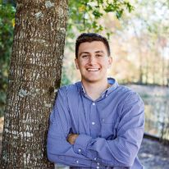
Mr. Braxton Chadwick, Graduating, May 2023
Hometown: Woodstock, GA, moved to Savannah, GA
Birth city: Savannah
Major/Expected graduation date: Middle Grades Education / Spring 2023
Post college plans: To go to graduate school and teach and coach at a local middle school
Braxton Chadwick’s Community Service in Metro Atlanta

Slide 10
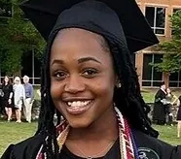
Ms. Sydnee Jordan-McCloud
Entering freshman, 2022-2023
Graduate of Kennesaw Mountain High School
Major: Electronics Engineering Technology

Slide 11
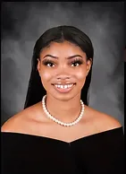
Ms. Khalia Knighton
Entering freshman, 2022-2023
Graduate of M.L.K. High School, Lithonia, GA
Major: Marketing Mgt.

Slide 12
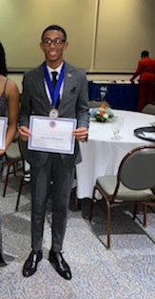
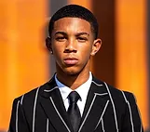
Mr. Alexander Jermaine (AJ) Richardson, Jr.
Hometown: Metro Atlanta
2021 Graduate of Riverdale High School
Major: Middle Grades Education, ELA and Social Studies
2022 Robert Noyce Internship/Scholarship program
Grade: Graduating 2024
Activities and societies: SGA | Mister Sophomore 21-22 ~Fall 2021 Initiate of SSU Chapter of Collegiate 100 (Vice President of Membership 2022-23)

